Slide 1
CS211 - Graduate Computer Architecture
Multiprocessor 2: Snooping Protocol, Directory Protocol, Synchronization, Consistency
Reference Textbook: “Computer Architecture - A Quantitative Approach” by Patterson and Hennesy - Third edition
The Bulk of These Notes are From The Textbook’s Resource Web Site and UCB’s CS152 and CS252
Adapted by
Rolando A. Fernandez

Slide 2
Potential HW Coherence Solutions
Snooping Solution (Snoopy Bus):
  Send all requests for data to all processors
  Processors snoop to see if they have a copy and respond accordingly
  Requires broadcast, since caching information is at processors
  Works well with bus (natural broadcast medium)
  Dominates for small scale machines (most of the market)
Directory-Based Schemes (discuss later)
  Keep track of what is being shared in 1 centralized place (logically)
  Distributed memory => distributed directory for scalability
  (avoids bottlenecks)
  Send point-to-point requests to processors via network
  Scales better than Snooping
  Actually existed BEFORE Snooping-based schemes

Slide 3
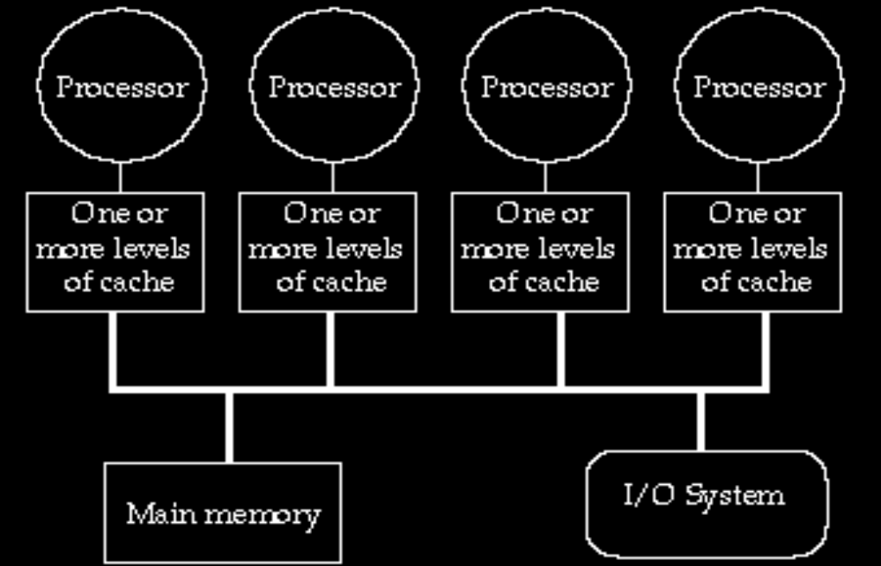
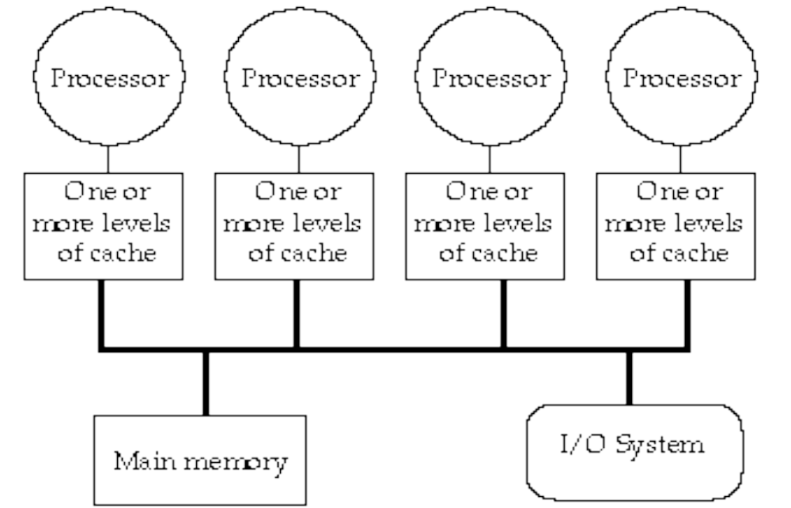
Bus Snooping Topology
Memory: centralized with uniform access time (“uma”) and bus interconnect
Examples: Sun Enterprise 5000 , SGI Challenge, Intel System Pro

Slide 4
Snooping Cache Variations
Basic
Protocol
Exclusive
Shared
Invalid
Berkeley
Protocol
Owned Exclusive
Owned Shared
Shared
Invalid
Illinois
Protocol
Private Dirty
Private Clean
Shared
Invalid
MESI
Protocol
Modfied (private,!=Memory)
Exclusive (private,=Memory)
Shared (shared,=Memory)
Invalid
Owner can update via bus invalidate operation
Owner must write back when replaced in cache
If read sourced from memory, then Private Clean
if read sourced from other cache, then Shared
Can write in cache if held private clean or dirty

Slide 5
Snoop Cache Extensions
CPU Read hit
Extensions:
  Fourth State: Ownership
Remote Write or
Miss due to
address conflict
Shared
(read/only)
  Shared-> Modified,
  need invalidate only (upgrade request), don’t read memory
  Berkeley Protocol
Invalid
CPU Read
Place read miss
on bus
CPU Write
Place Write
Miss on bus
Remote
Write
or Miss due to
address conflict
Write back block
Remote
Read
Place Data
on Bus?
Remote Read
Write back
block
  Clean exclusive state (no miss for private data on write)
  MESI Protocol
CPU Write
Place Write
Miss on
Bus
Exclusive (read/only)
  Cache supplies data when shared state
  (no memory access)
  Illinois Protocol
Modified
(read/write)
CPU read hit
CPU write hit
CPU Write
Place Write
Miss on Bus?
CPU Read hit

Slide 6
Larger MPs
Separate Memory per Processor
Local or Remote access via memory controller
1 Cache Coherency solution: non-cached pages
Alternative: directory per cache that tracks state of every block in every cache
  Which caches have a copies of block, dirty vs. clean, ...
Info per memory block vs. per cache block?
  PLUS: In memory => simpler protocol (centralized/one location)
  MINUS: In memory => directory is ƒ(memory size) vs. ƒ(cache size)
Prevent directory as bottleneck?
distribute directory entries with memory, each keeping track of which Procs have copies of their blocks

Slide 7
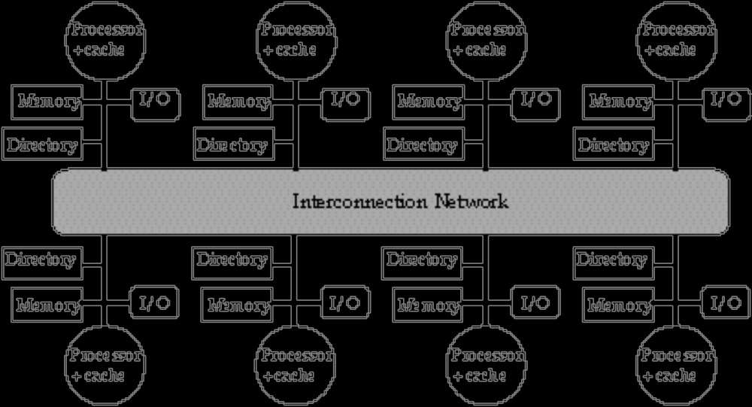
Distributed Directory MPs

Slide 8
Directory Protocol
Similar to Snoopy Protocol: Three states
  Shared: ≥ 1 processors have data, memory up-to-date
  Uncached (no processor has it; not valid in any cache)
  Exclusive: 1 processor (owner) has data;
  memory out-of-date
In addition to cache state, must track which processors have data when in the shared state (usually bit vector, 1 if processor has copy)
Keep it simple(r):
  Writes to non-exclusive data
  => write miss
  Processor blocks until access completes
  Assume messages received
  and acted upon in order sent

Slide 9
Directory Protocol
No bus and don’t want to broadcast:
  interconnect no longer single arbitration point
  all messages have explicit responses
Terms: typically 3 processors involved
  Local node where a request originates
  Home node where the memory location
  of an address resides
  Remote node has a copy of a cache
  block, whether exclusive or shared
Example messages on next slide:
P = processor number, A = address

Slide 10
Directory Protocol Messages
Message type Source Destination Msg Content
Read miss Local cache Home directory P, A
  Processor P reads data at address A;
  make P a read sharer and arrange to send data back
Write miss Local cache Home directory P, A
  Processor P writes data at address A;
  make P the exclusive owner and arrange to send data back
Invalidate Home directory Remote caches A
  Invalidate a shared copy at address A.
Fetch Home directory Remote cache A
  Fetch the block at address A and send it to its home directory
Fetch/Invalidate Home directory Remote cache A
  Fetch the block at address A and send it to its home directory; invalidate the block in the cache
Data value reply Home directory Local cache Data
  Return a data value from the home memory (read miss response)
Data write-back Remote cache Home directory A, Data
  Write-back a data value for address A (invalidate response)

Slide 11
State Transition Diagram for an Individual Cache Block in a Directory Based System
States identical to snoopy case; transactions very similar.
Transitions caused by read misses, write misses, invalidates, data fetch requests
Generates read miss & write miss msg to home directory.
Write misses that were broadcast on the bus for snooping => explicit invalidate & data fetch requests.
Note: on a write, a cache block is bigger, so need to read the full cache block

Slide 12
CPU -Cache State Machine
CPU Read hit
State machine
for CPU requests
for each
memory block
Invalid state
if in
memory
Invalidate
Shared
(read/only)
Invalid
CPU Read
Send Read Miss
message
CPU read miss:
Send Read Miss
CPU Write:
Send Write Miss
msg to h.d.
CPU Write:Send
Write Miss message
to home directory
Fetch/Invalidate
send Data Write Back message
to home directory
Fetch: send Data Write Back message to home directory
CPU read miss: send Data Write Back message and read miss to home directory
Exclusive
(read/writ)
CPU read hit
CPU write hit
CPU write miss:
send Data Write Back message
and Write Miss to home
directory
Notes:
Invalid:
read => shared
write => dirty
shared looks the same

Slide 13
State Transition Diagram for the Directory
Same states & structure as the transition diagram for an individual cache
2 actions: update of directory state & send messages to satisfy requests
Tracks all copies of memory block.
Also indicates an action that updates the sharing set, Sharers, as well as sending a message.

Slide 14
Directory State Machine
Read miss:
Sharers += {P};
send Data Value Reply
State machine
for Directory requests for each
memory block
Uncached state
if in memory
Read miss:
Sharers = {P}
send Data Value
Reply
Shared
(read only)
Uncached
Write Miss:
Sharers = {P};
send Data
Value Reply
msg
Write Miss:
send Invalidate
to Sharers;
then Sharers = {P};
send Data Value
Reply msg
Data Write Back:
Sharers = {}
(Write back block)
Read miss:
Sharers += {P};
send Fetch;
send Data Value Reply
msg to remote cache
(Write back block)
Write Miss:
Sharers = {P};
send Fetch/Invalidate;
send Data Value Reply
msg to remote cache
Exclusive
(read/writ)
Notes:
Invalid:
read => shared
write => dirty
shared looks the same

Slide 15
Example Directory Protocol
Message sent to directory causes two actions:
  Update the directory
  More messages to satisfy request
Block is in Uncached state: the copy in memory is the current value; only possible requests for that block are:
  Read miss: requesting processor sent data from memory &requestor made only sharing node; state of block made Shared.
  Write miss: requesting processor is sent the value & becomes the Sharing node. The block is made Exclusive to indicate that the only valid copy is cached. Sharers indicates the identity of the owner.
Block is Shared => the memory value is up-to-date:
  Read miss: requesting processor is sent back the data from memory & requesting processor is added to the sharing set.
  Write miss: requesting processor is sent the value. All processors in the set Sharers are sent invalidate messages, & Sharers is set to identity of requesting processor. The state of the block is made Exclusive.

Slide 16
Example Directory Protocol
Block is Exclusive: current value of the block is held in the cache of the processor identified by the set Sharers (the owner) => three possible directory requests:
  Read miss: owner processor sent data fetch message, causing state of block in owner’s cache to transition to Shared and causes owner to send data to directory, where it is written to memory & sent back to requesting processor.
  Identity of requesting processor is added to set Sharers, which still contains the identity of the processor that was the owner (since it still has a readable copy). State is shared.
  Data write-back: owner processor is replacing the block and hence must write it back, making memory copy up-to-date
  (the home directory essentially becomes the owner), the block is now Uncached, and the Sharer set is empty.
  Write miss: block has a new owner. A message is sent to old owner causing the cache to send the value of the block to the directory from which it is sent to the requesting processor, which becomes the new owner. Sharers is set to identity of new owner, and state of block is made Exclusive.

Slide 17
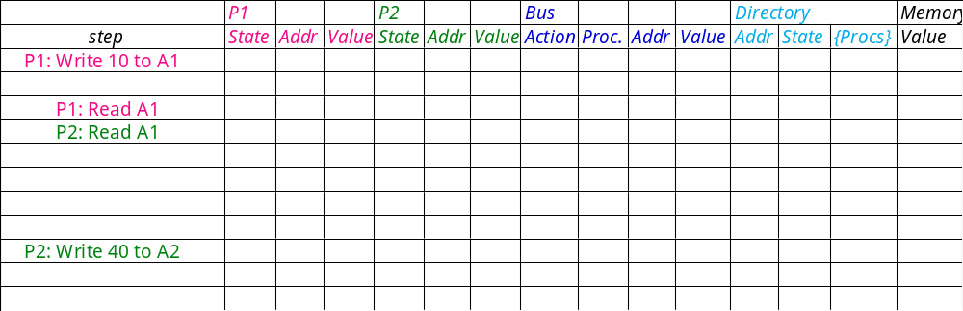
Example
Processor 1
Processor 2
Interconnect
Directory
Memory
P2: Write 20 to A1
A1 and A2 map to the same cache block

Slide 18
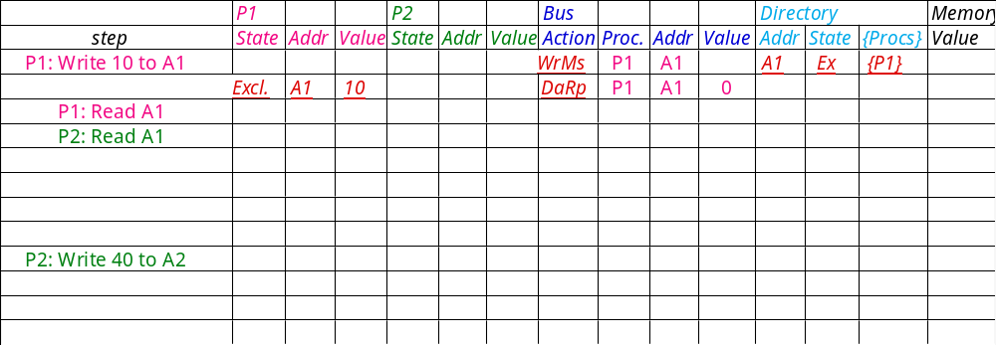
Example
Processor 1
Processor 2
Interconnect
Directory
Memory
P2: Write 20 to A1
A1 and A2 map to the same cache block

Slide 19
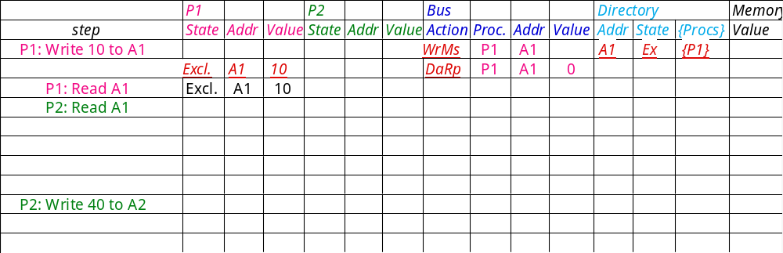
Example
Processor 1
Processor 2
Interconnect
Directory
Memory
P2: Write 20 to A1
A1 and A2 map to the same cache block

Slide 20
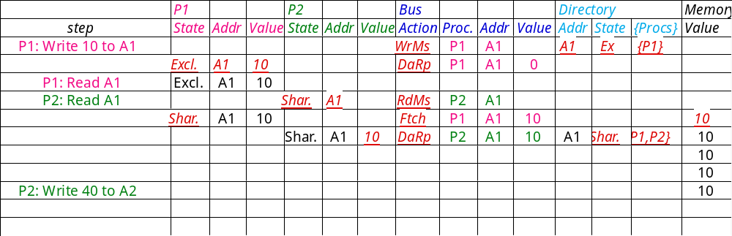
Example
Processor 1
Processor 2
Interconnect
Directory
Memory
A1
A1
P2: Write 20 to A1
Write Back
A1 and A2 map to the same cache block

Slide 21
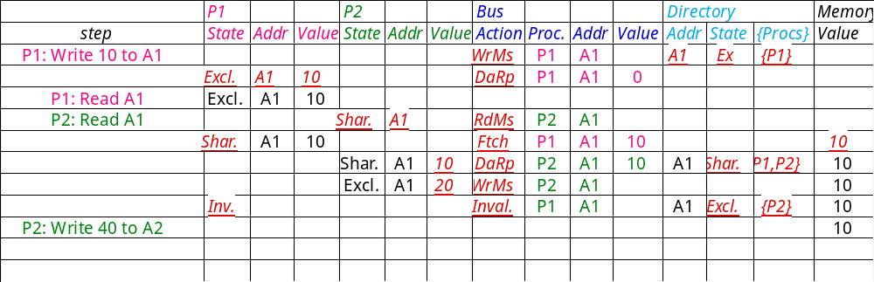
Example
Processor 1
Processor 2
Interconnect
Directory
Memory
A1
A1
P2: Write 20 to A1
A1 and A2 map to the same cache block

Slide 22
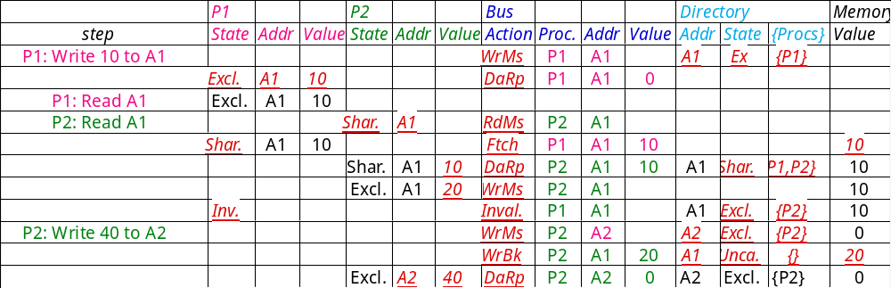
Example
Processor 1
Processor 2
Interconnect
Directory
Memory
A1
A1
P2: Write 20 to A1
A1 and A2 map to the same cache block

Slide 23
Implementing a Directory
We assume operations atomic, but they are not; reality is much harder; must avoid deadlock when run out of buffers in network
Optimizations:
  read miss or write miss in Exclusive: send data directly to requestor from owner vs. 1st to memory and then from memory to requestor

Slide 24
Summary
Caches contain all information on state of cached memory blocks
Snooping and Directory Protocols similar; bus makes snooping easier because of broadcast (snooping => uniform memory access)
Directory has extra data structure to keep track of state of all cache blocks
Distributing directory => scalable shared address multiprocessor
=> Cache coherent, Non uniform memory access

